Slide 1
DEMOGRAPHIC ANALYSIS OF CRIMES & VICTIMIZATIONS
Dhruv Sharma
76749332
dsx11@uclive.ac.nz

Slide 2
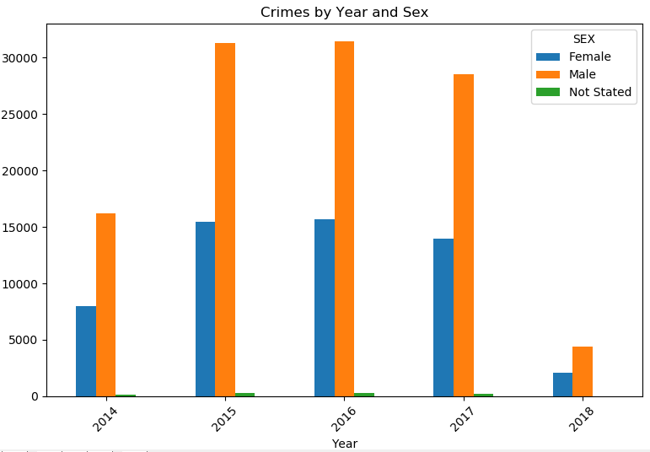
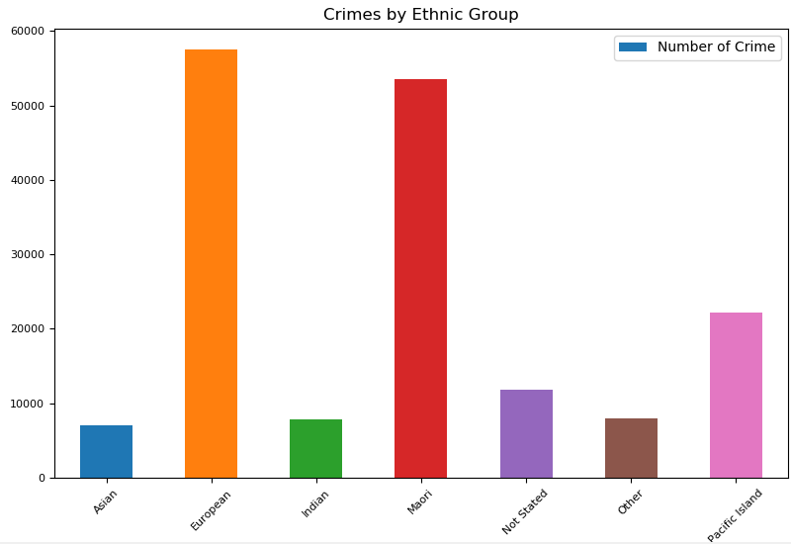
Objectives & Findings
To perform criminal profiling based on the demographic factors available for crimes and victimizations in various regions across New Zealand.
Exploratory analysis using Python Pandas package done for offenders data and Crimes & Victimizations data helping us perform custom analysis of the data.
There are a total of 413740 records that we have analyzed. Data time period – 2014 till date.
Males have been committing almost 2 times more crimes as compared to females.
Out of the total, half of the total crimes are committed by people aged between 15 to 35.
There is a significant Year on Year increase in crimes committed in 2014 to 2015 as compared other years.
We can identify that the proportion of crimes committed by the people of a particular ethnicity is in proportion to the ethnic population in the country.
Dhruv Sharma 76749332

Slide 3
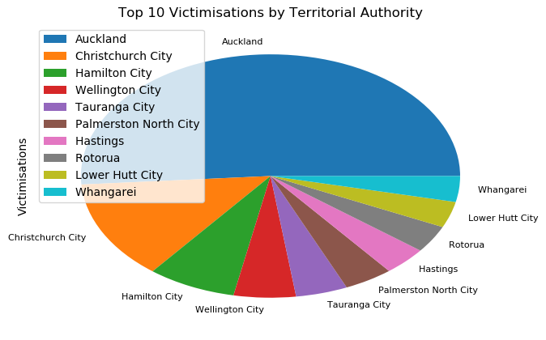
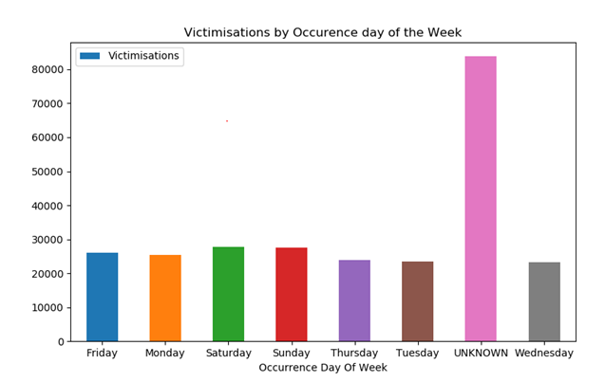
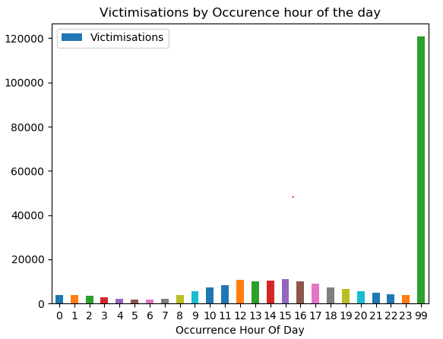
More people are victimised in the day time, opposite to belief of having more victimisations during night time.
We see that there are more crimes during the weekend as compared to the week days.
Auckland and Chrisrtchurch lead the way in highest number of victimizations. As the area of the city increased, trend for number of victimizations also increased proportionality.
Administrative and Professional locations were the locations where the maximum number of crimes took place.
Add on – Ad-hoc Analysis using Python program.

